Slide 1

Energy Consumption Prediction in Smart Buildings
Leveraging Machine Learning to Optimize Energy Efficiency and Reduce Costs

Slide 2


Signature fraud is a common issue in banking, legal, and
other industries. Manual verification is time-consuming
and prone to errors.
What is Smart Buildings:
Smart buildings are structures equipped with advanced technologies, such as IoT sensors and automation systems, to monitor, optimize, and control energy usage, comfort, and security efficiently in real-time.

Slide 3
Energy Consumption Challenges in Smart Buildings
Inefficient Energy Usage:
Lack of real-time monitoring leads to excessive energy wastage.
Inefficient appliances and outdated systems increase operational costs.
Environmental Impact:
Excessive energy consumption contributes to higher carbon emissions.
Non-optimized energy systems fail to support sustainability goals.
Scalability:
Smart systems for predictive and efficient energy management.
Machine learning-based models to forecast and reduce energy usage.
Integration with IOT devices for real time energy monitoring.

Slide 4
Objective
To develop an advanced machine learning model to predict and optimize energy consumption in smart buildings
Key Objectives:
Accurate prediction of energy usage patterns
Optimized energy efficiency to reduce costs and environmental impact
Scalable solution for integration into diverse smart building systems

Slide 5
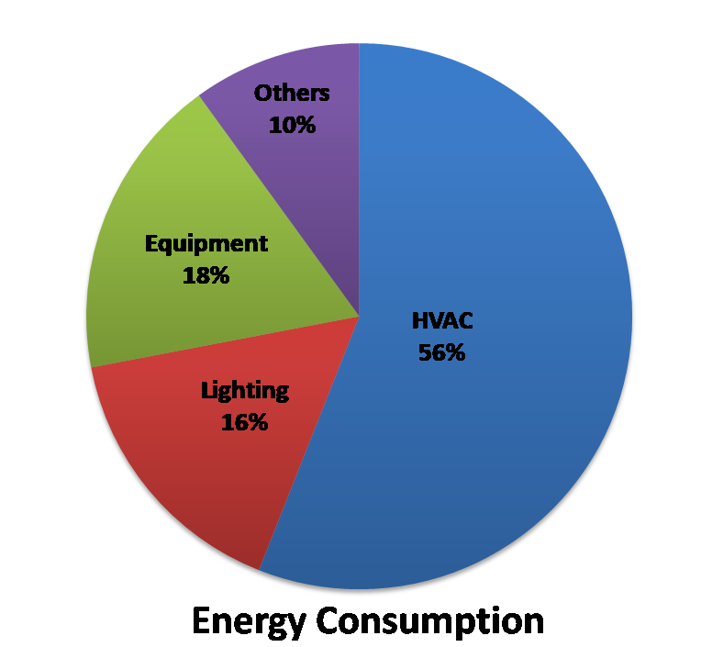

Key Components of Energy Consumption Analysis
1.Data Collection:
Gather dataset from Kaggle, a platform known for it’s vast collection of high
quality datasets.
2.Types of Energy Data:
Include electricity, lighting, and renewable energy sources.
3.Data Processing:
Aggregate data from multiple sources for comprehensive analysis.
4.Preprocessing Techniques:
Use cleaning, normalization, and encoding to prepare data for modeling.
5.Feature Engineering:
Extract key features like peak usage times and seasonal variations.
6.Energy Usage Patterns:
Identify trends and anomalies to optimize consumption.
7.Predictive Modeling:
Apply machine learning to forecast future energy demands.
8.Visualization Tools:
Use dashboards to present insights in an interactive format.

Slide 6
Machine Learning Techniques in Energy Consumption
Types of Machine Learning Approaches:
Regression: Predicts continuous energy consumption values.
Classification: Categorizes energy usage into predefined levels
Why Regression:
Continuous energy consumption values are required for precise
predictions.
Selected Algorithms:
1.Regression Algorithms
Random forest regression algorithm
Support vector regression algorithm
2.Boosting Algorithm
XGBoost

Slide 7
Comparison of model performance
 | Random Forest Regression | Support Vector Regression | XGBoost
MSE | 0.26 | 0.84 | 0.44
RMSE | 0.51 | 0.92 | 0.27
MAE | 0.43 | 0.66 | 0.52
R-Squared | 0.77 | 0.26 | 0.76

Slide 8
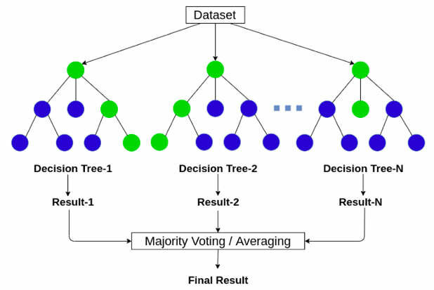

Random forest Algorithm:
Definition:
Refers to the process of applying the Random Forest
algorithm to solve regression problems.
Why Random Forest:
1. Robust and Accurate Predictions:
Combines multiple decision trees to reduce overfitting and improve
prediction accuracy
2. Feature Importance Analysis:
Provides insights into which features contribute most to the predictions,
aiding in better understanding of energy consumption patterns.

Slide 9
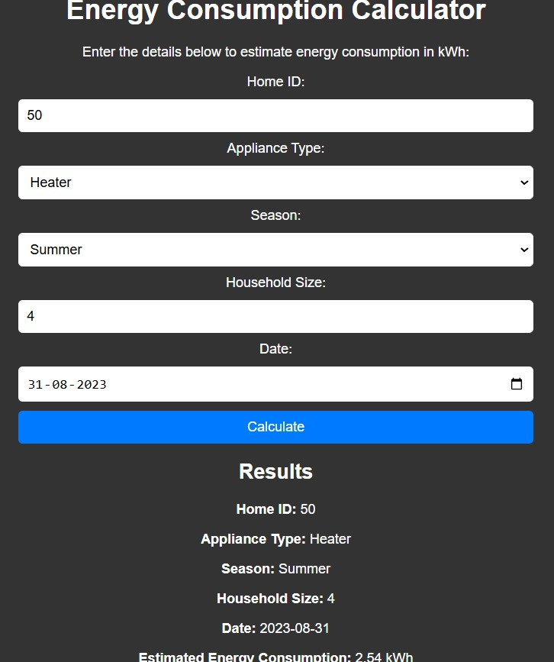
Results and insights
High prediction Accuracy: achieved an R square score of 0.77, indicating strong correlation between predicted and actual energy consumption.
Key Energy Drivers Identified: Features like appliance type, outdoor temperature, and time of day were found to significantly influence energy consumption.
Interactive Dashboard for smart monitoring: Developed a user-friendly dashboard to visualize energy usage patters, detect anomalies, and provide actionable insights for optimization.

Slide 10

Interpretability of Results:
Making predictions explainable to stakeholders.
Dashboard:
Developed a dashboard to visualize energy consumption trends.
User Adoption:
Encouraging users to trust and use predictions.
Simplified user-friendly interface
Scalability:
Ensuring the model scales well for larger datasets or multiple buildings.
Tested the model on varying data sizes.

Slide 11



Future scope
Dynamic Model Updates:
Integration of live sensor data.
Scalability:
Expand to include more applications and features
Integration:
Smart home automation systems.
Mobile Application:
Predict energy consumption on-the-go.
Integration with Building Management Systems (BMS):
Automate energy control through real-time
feedback loops.

Slide 12
Conclusion
This Project created a reliable system for predicting energy consumption using factors like temperature, time. It addressed challenges like data quality and user adoption through robust preprocessing and user-friendly interfaces. The system enhances energy efficiency, supports sustainability, and offers future scalability for integration with smart home automation and mobile applications.

Slide 13


